Slide 1

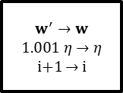

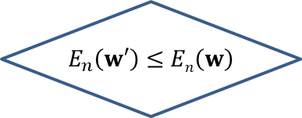
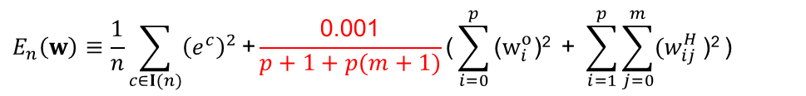

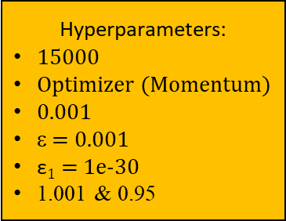
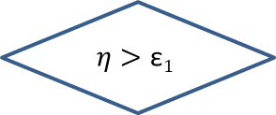

The regularizing module
Acceptable net
A net coming from the matching module
$$\text{}$$
A
$$E_{n}\left(w\right)≡\frac{1}{n}\sum_{c∈I(n)}{{\left(e^{c}\right)}^{2}}\text{+}\frac{\text{0.001}}{p+1+p(m+1)}\text{(}\sum_{i=0}^{p}{\text{(}w_{i}^{o}\text{)}\text{2}}\text{ + }\sum_{i=1}^{p}{\sum_{j=0}^{m}{{(w}_{ij}^{H}}\text{)}\text{2}}\text{)}$$
True
$$η$$
i = 1
SeC
True
i ≥ 15000
B
Flase
Unacceptable net
False
Store w
Hyperparameters:
15000
Optimizer (Momentum)
0.001
ε = 0.001
$\text{ε}1$ = 1e-30
1.001 & 0.95
backward operation to obtain $w′$
$w^{′}→w$ $$1.001 η→η$$
i+1 $→$ i
forward operation
Restore w
& $0.95η→η$
$$E_{n}\left(w′\right)≤En\left(w\right)$$
True
False
Acceptable net
True
A
$$η>\text{ε}1$$
SeC
True
False
Restore w
Unacceptable net
Flase
B

Slide 2
Issues
鼓勵，要專業 ← Two possible results: A or B ← regularizing is not matching
Weight-tuning does not guarantee SeC ← the gradient descent method does not guarantee the global minimum. The learning goal (|error| < epsilon, SeC, or …) cannot be guaranteed by any gradient descent method. Therefore, two possible results.
To make the reorganizing work, the regularizing should result in only one possible result, i.e., the acceptable SLFN.
implementation issues: e.g., 15000 ← annealing (焠火); long training time (inefficiency), …

Slide 3
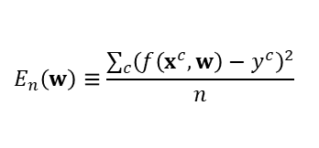
Matching
$$E_{n}\left(w\right)≡\frac{\sum_{c}{{\left(f\left(x^{c},w\right)−y^{c}\right)}^{2}}}{n}$$
Hyperparameters:
100
Optimizer
Learning rate = 0.01
ε
i = 1
i++
forward
operation
False
i ≥ 100
SeC
backward operation
False
True
True
B
Unacceptable SLFN
Acceptable SLFN
A

Slide 4

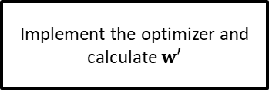
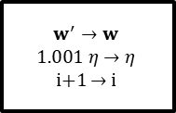
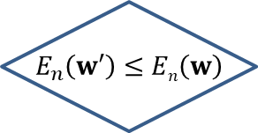

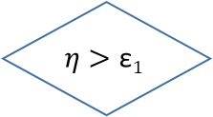
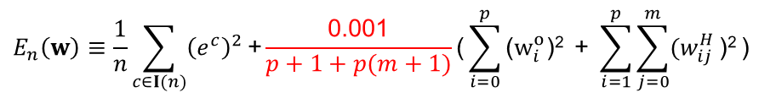
Regularizing
$$E_{n}\left(w\right)≡\frac{1}{n}\sum_{c∈I(n)}{{\left(e^{c}\right)}^{2}}\text{+}\frac{\text{0.001}}{p+1+p(m+1)}\text{(}\sum_{i=0}^{p}{\text{(}w_{i}^{o}\text{)}\text{2}}\text{ + }\sum_{i=1}^{p}{\sum_{j=0}^{m}{{(w}_{ij}^{H}}\text{)}\text{2}}\text{)}$$
The acceptability is determined by SeC
An acceptable SLFN that accomplishes the learning goal
$$η$$
i = 1
An acceptable SLFN that has a preference on weights
true
i >= 15000
false
Hyperparameters:
15000
Optimizer (Momentum)
0.001
ε = 0.001
$\text{ε}1$ = 1e-30
1.001 & 0.95
Store w
Implement the optimizer and calculate $w′$
$w^{′}→w$ $$1.001 η→η$$
i+1 $→$ i
Forward operation
Restore w
& $0.95η→η$
$$E_{n}\left(w′\right)≤En\left(w\right)$$
SeC
true
true
false
false
true
$$η>\text{ε}1$$
false
An acceptable SLFN that has a preference on weights
Restore w

Slide 5
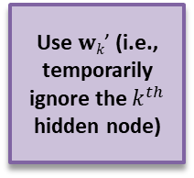
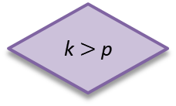
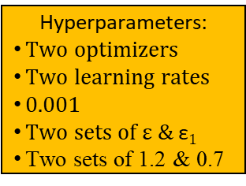
Reorganizing
Hyperparameters:
Two optimizers
Two learning rates
0.001
Two sets of ε & $\text{ε}1$
Two sets of 1.2 & 0.7
The acceptability is SeC
Restore the network and w
k ++
p --
A
B
An acceptable SLFN
k $>$p
Regularizing
Use $wk\text{’}$ (i.e., temporarily ignore the $k^{th}$ hidden node)
Matching(100)
k = 1
False
Store the network and w
True
An acceptable SLFN

Slide 6
The proposed learning algorithm
(in flowchart)
True
n ≥ N
False
Selecting
learning goal
False
Save w
True
Matching
A
n ++
Reorganizing
Cramming
Restore w
B
Initializing
6

Slide 7
HW#8要呈現的資料
一併附上HW#7以及code
Debug each block/module through printing out some information regarding it. ← Fix the bugs of each block/module or replace it.
Debug the consistency amongst several consecutive blocks through printing out some information regarding the data flow of these consecutive blocks. ← Fix the inconsistency via fine-tuning or replacing some blocks.
Debug the logic of the whole algorithm through printing out some results. ← Fix the logic via fine-tuning some blocks or replacing them.

